Slide 1
An Analysis of Alaskan Weather
Jene’ Rigaud

Slide 2
Data
This dataset was found on NASA’s Earth Data library, and originated from the National Center for Atmospheric Research in Boulder, Colorado.
It contains the historical, current, and future climate information of Alaska based on an annual 1% increase in greenhouse gases. Based on this historical data, future anticipated data is also included.
Variables of focus were irradiation, precipitation, average temperature, relative humidity, vapor pressure, irradiation, heat index, dewpoint and solar radiation.
Original dataset contained 7,7547,904 rows and 14 columns

Slide 3

Modules Used
Numpy, Pandas, Matplotlib
Metpy, Scipy, Seaborn, Cartopy, Xarray

Slide 4

Data Reduction
First, the data was imported using xarray and converted into a pandas dataframe for easy handling
To reduce the length and remove outliers, all Nan values were removed and the scipy function zscore was used
Working data frame was now 3,642,126 rows
Although it appears that a lot of data is missing, most of the removed values were Nan and served no purpose for the analysis

Slide 5
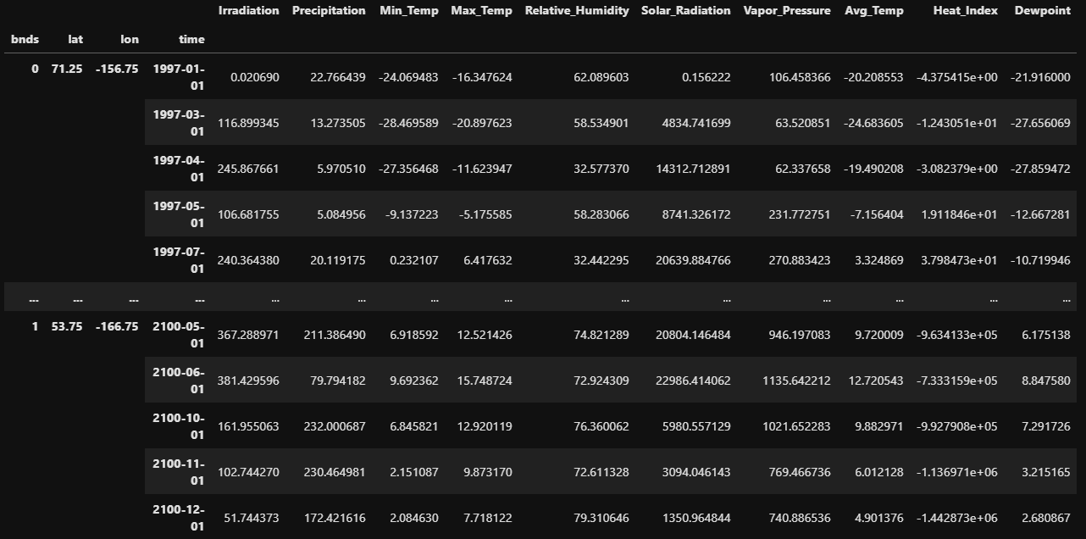
Working Dataframe

Slide 6
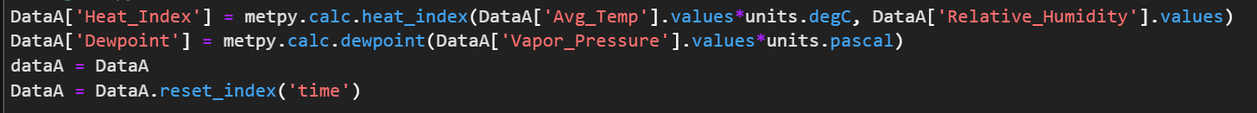
Methods
Using metpy, 2 new variables were created from the existing data set
Avg. Temp
Ambient Dewpoint
Heat Index

Slide 7
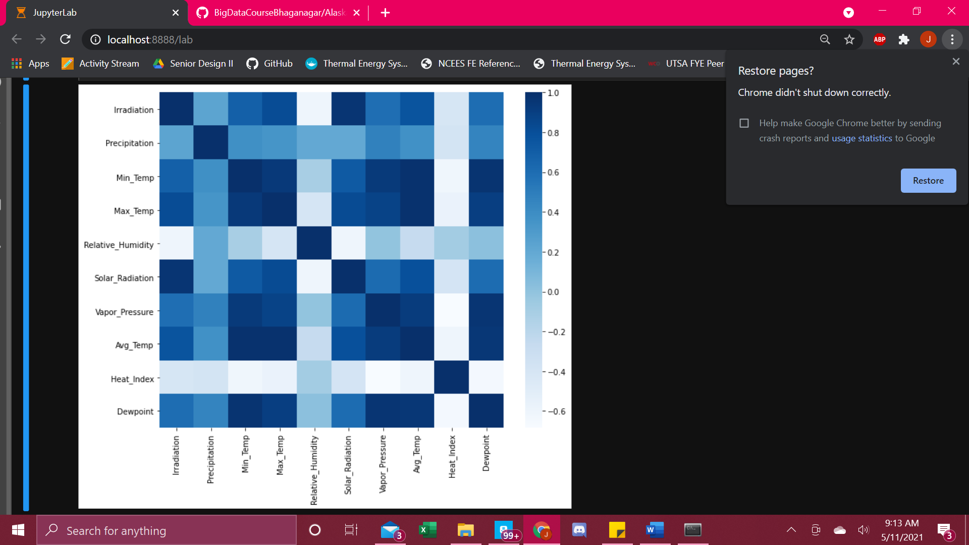

Correlation Analysis
A correlation analysis was first done on all variables using the seaborn heatmap.
The average temperature had the strongest correlations with other variables, while the relative humidity and heat index had the least

Slide 8

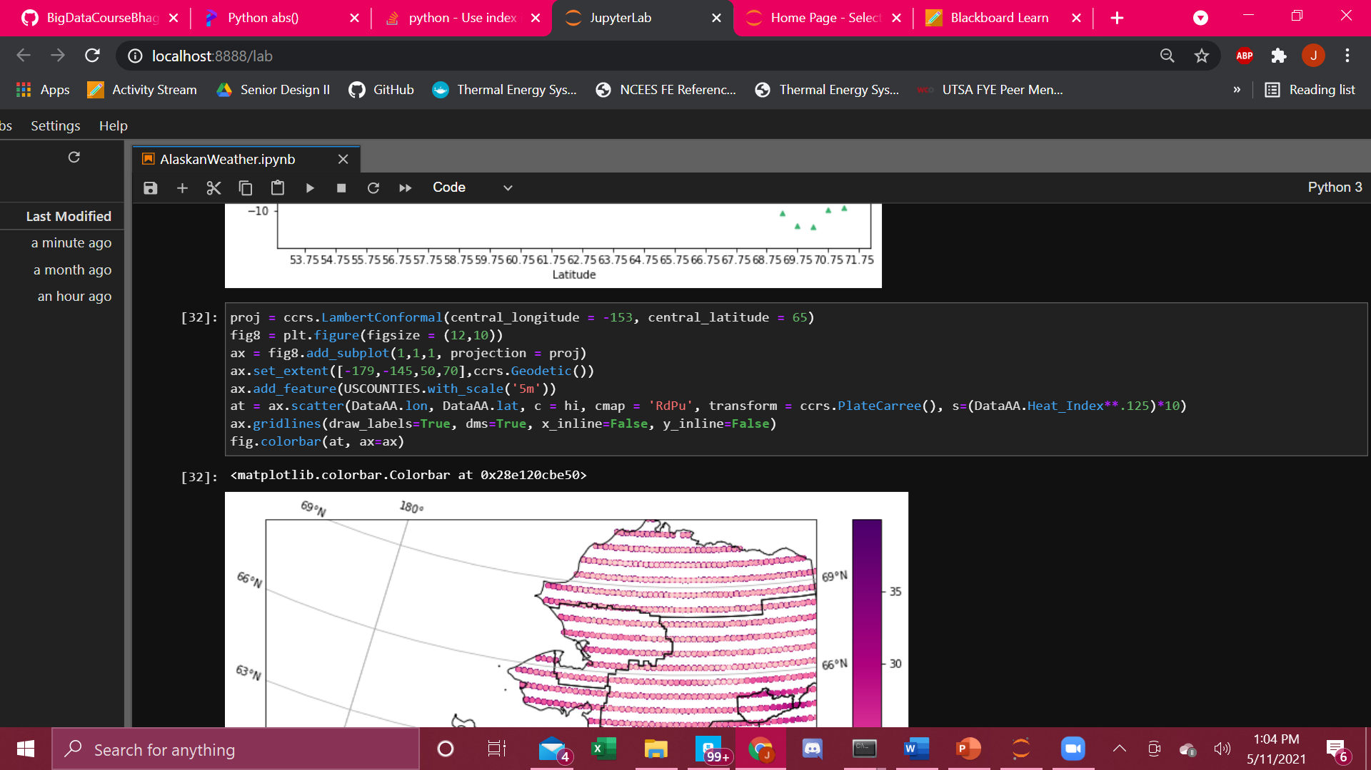
Correlation Analysis
Next, I wanted to see the relationship between the latitude coordinate and some of the other variables
Created my own heatmap using cartopy, metpy, and matplotlib
Desired variables were 1st converted to an array so a cmap could be used

Slide 9
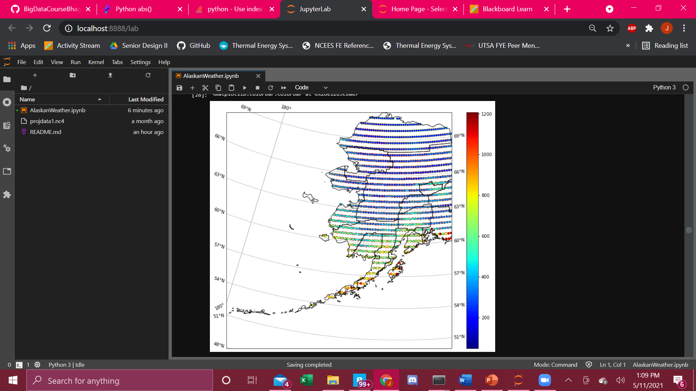
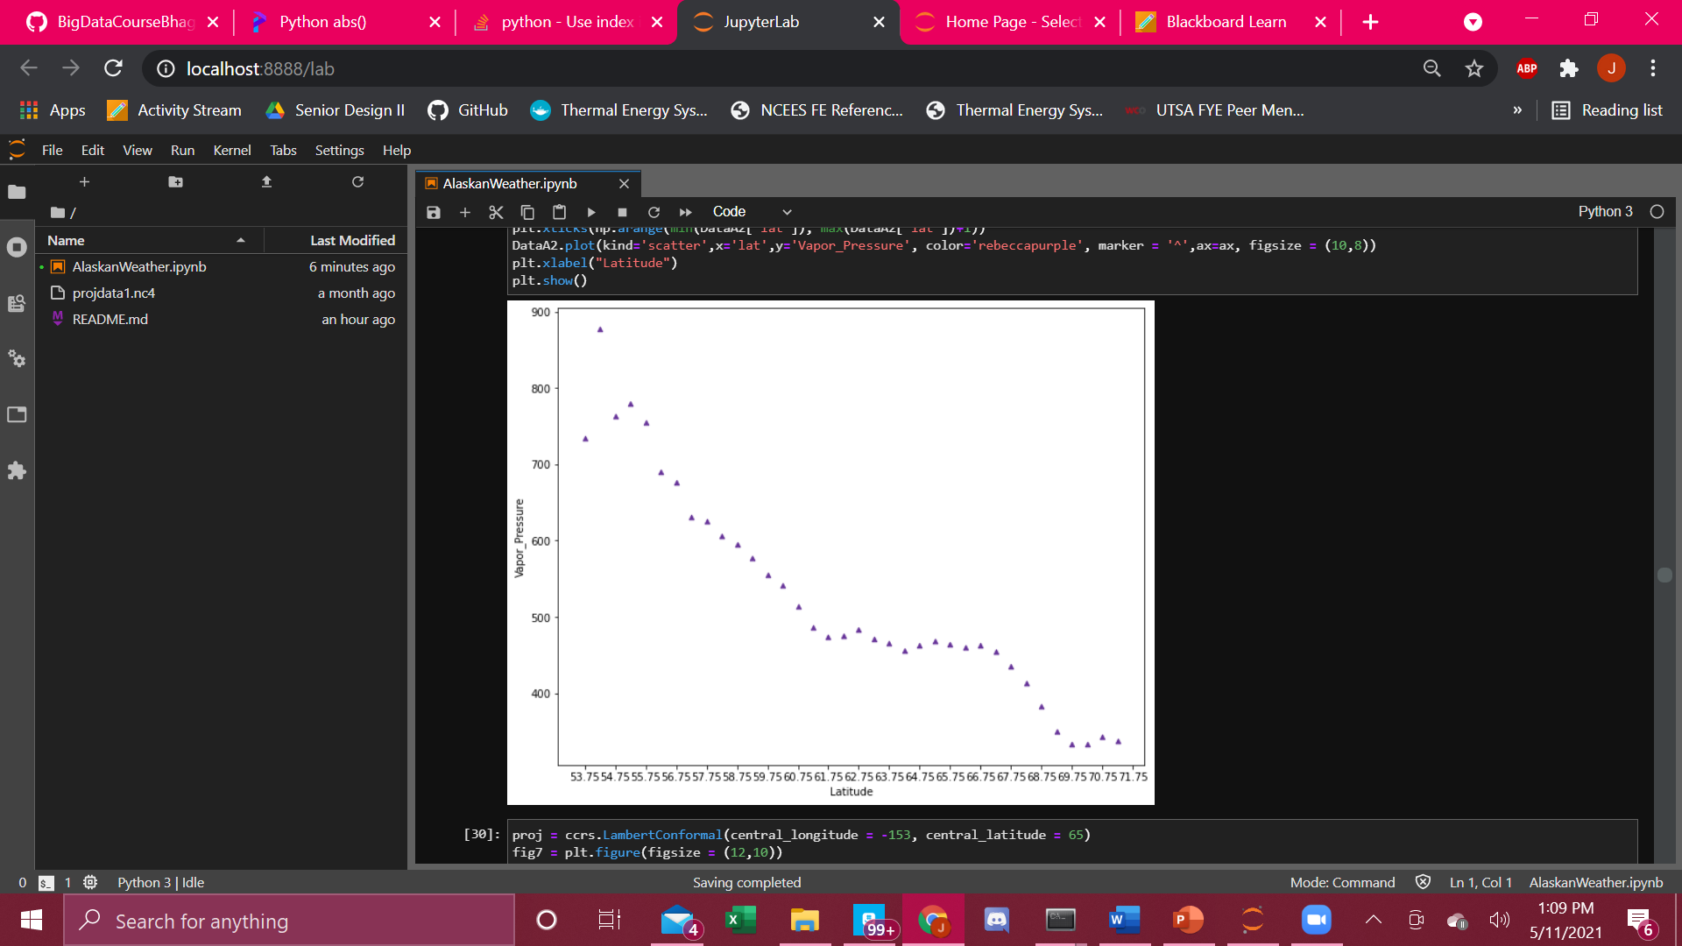
Correlation Analysis

Slide 10
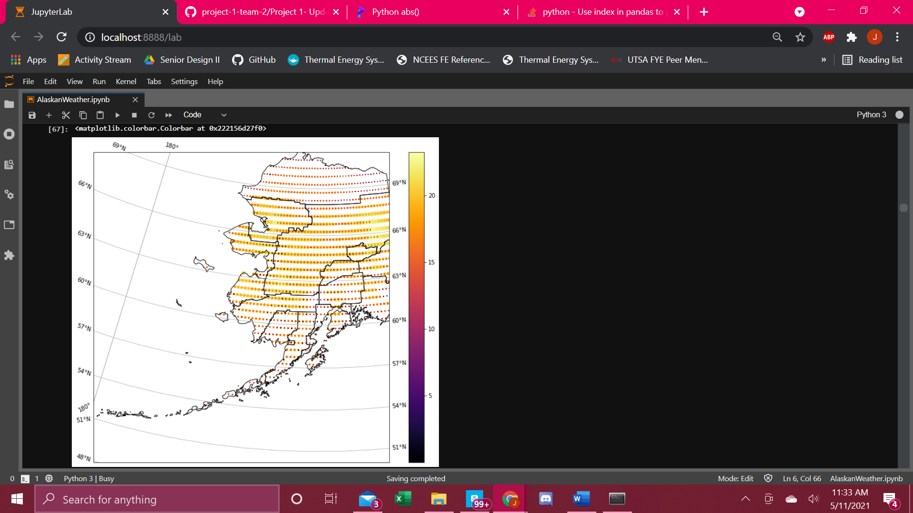
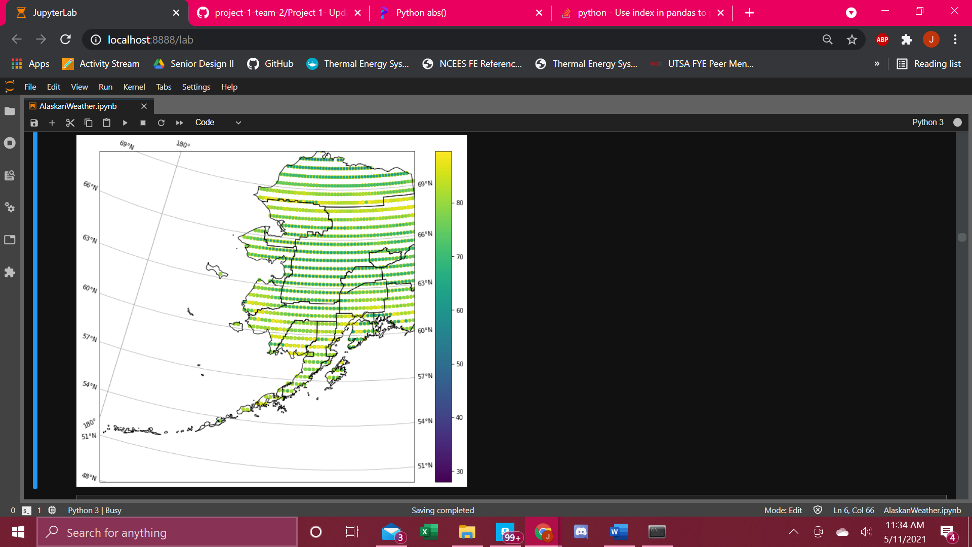
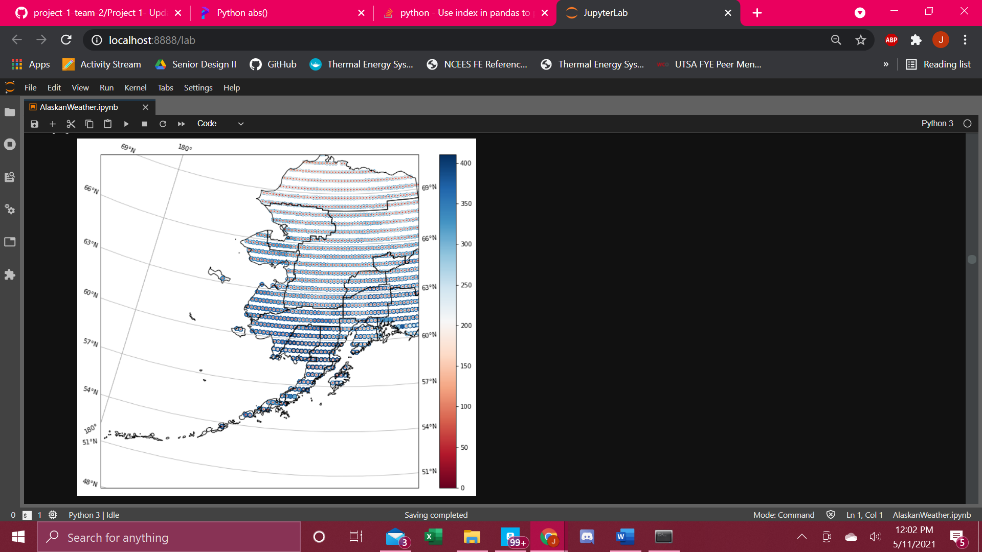
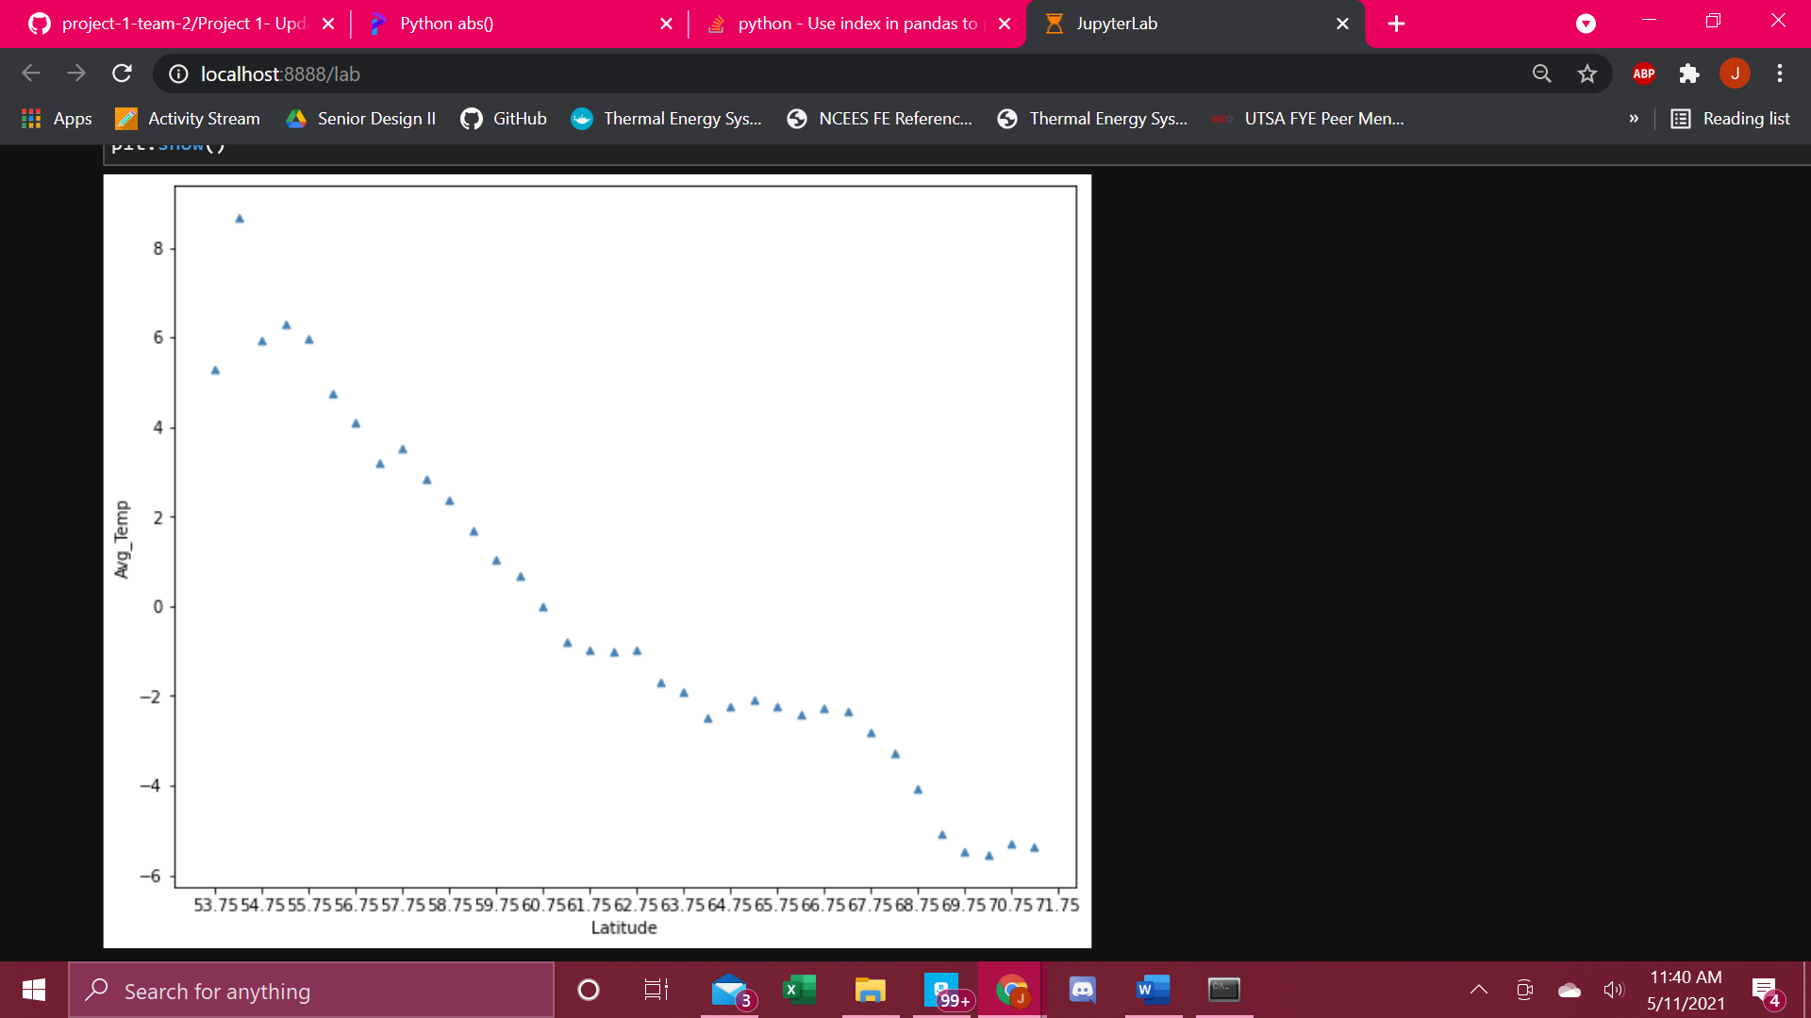
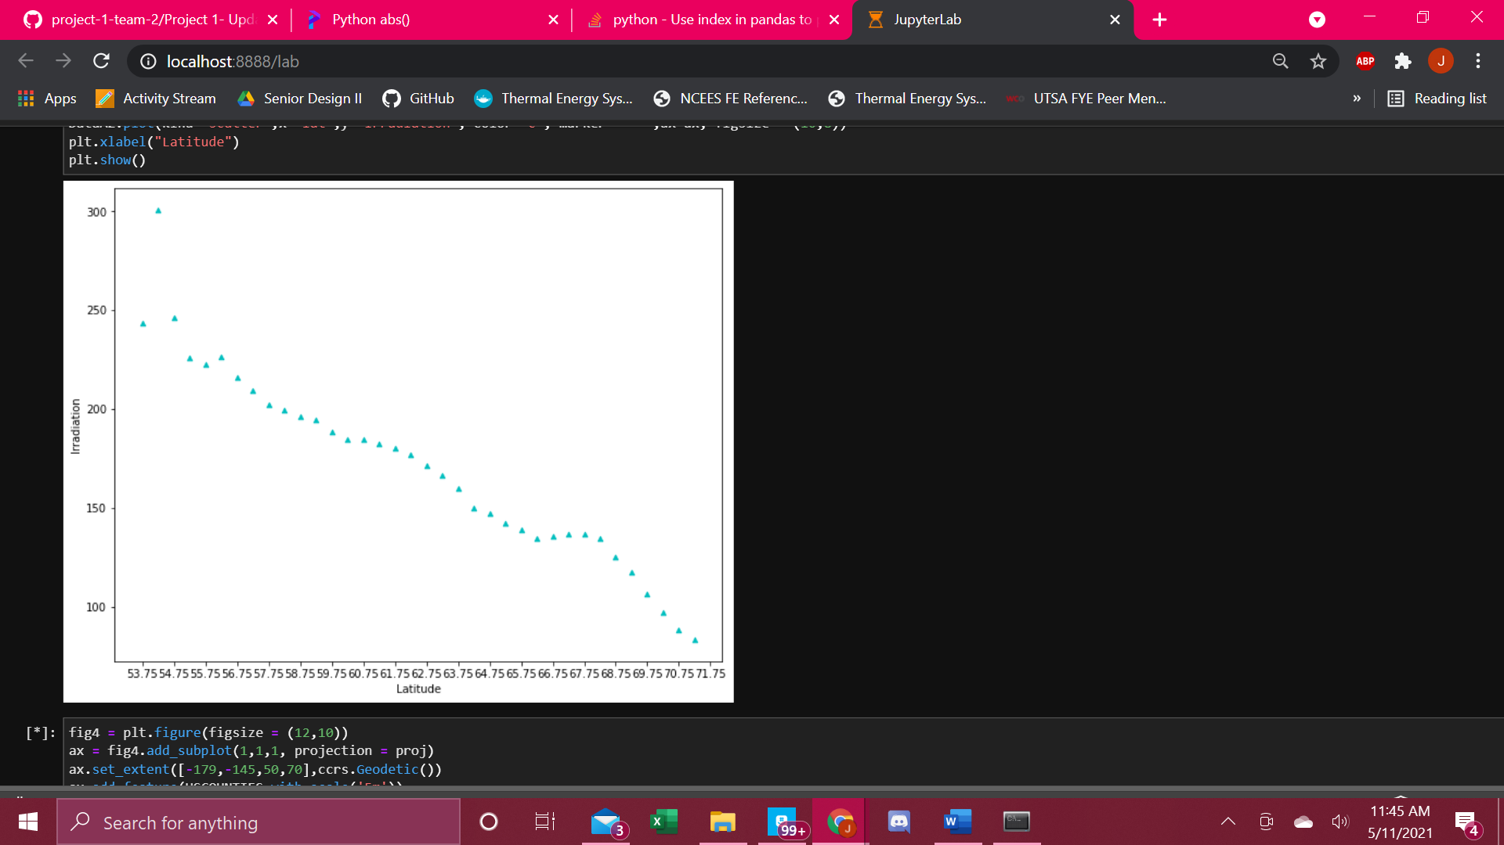
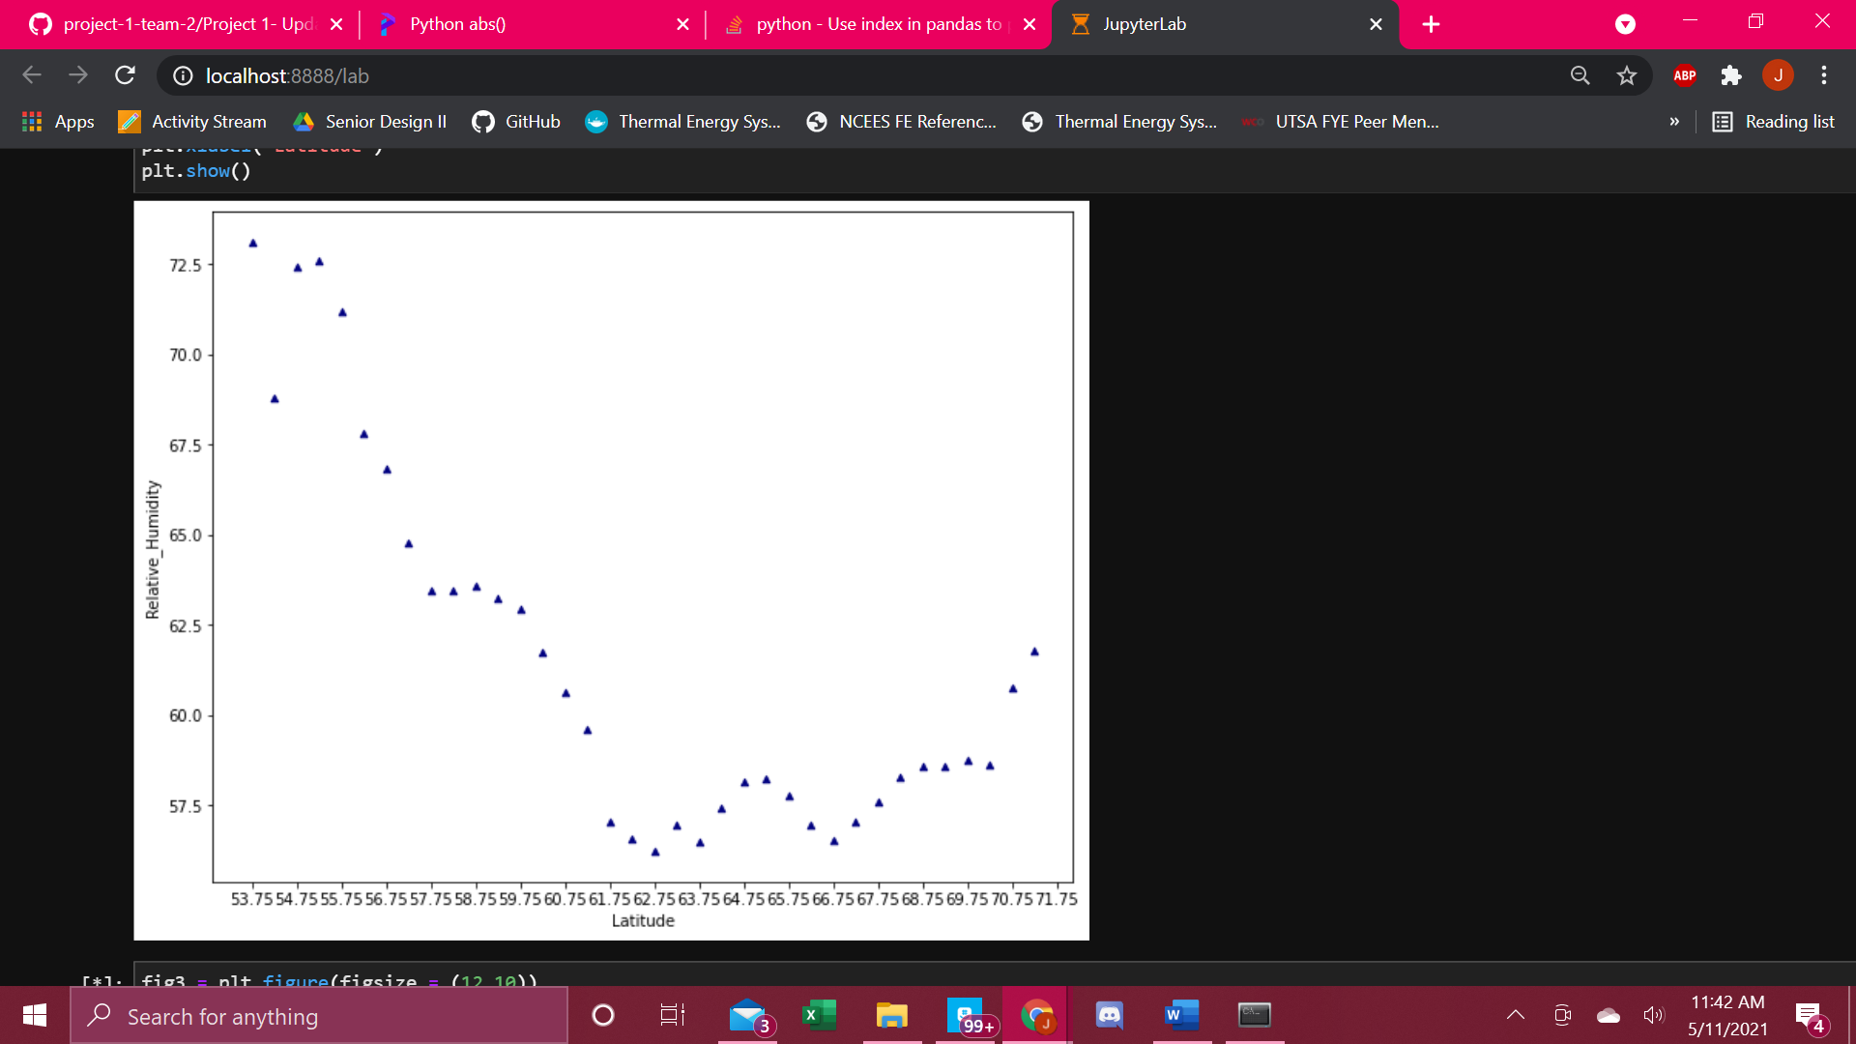

Slide 11
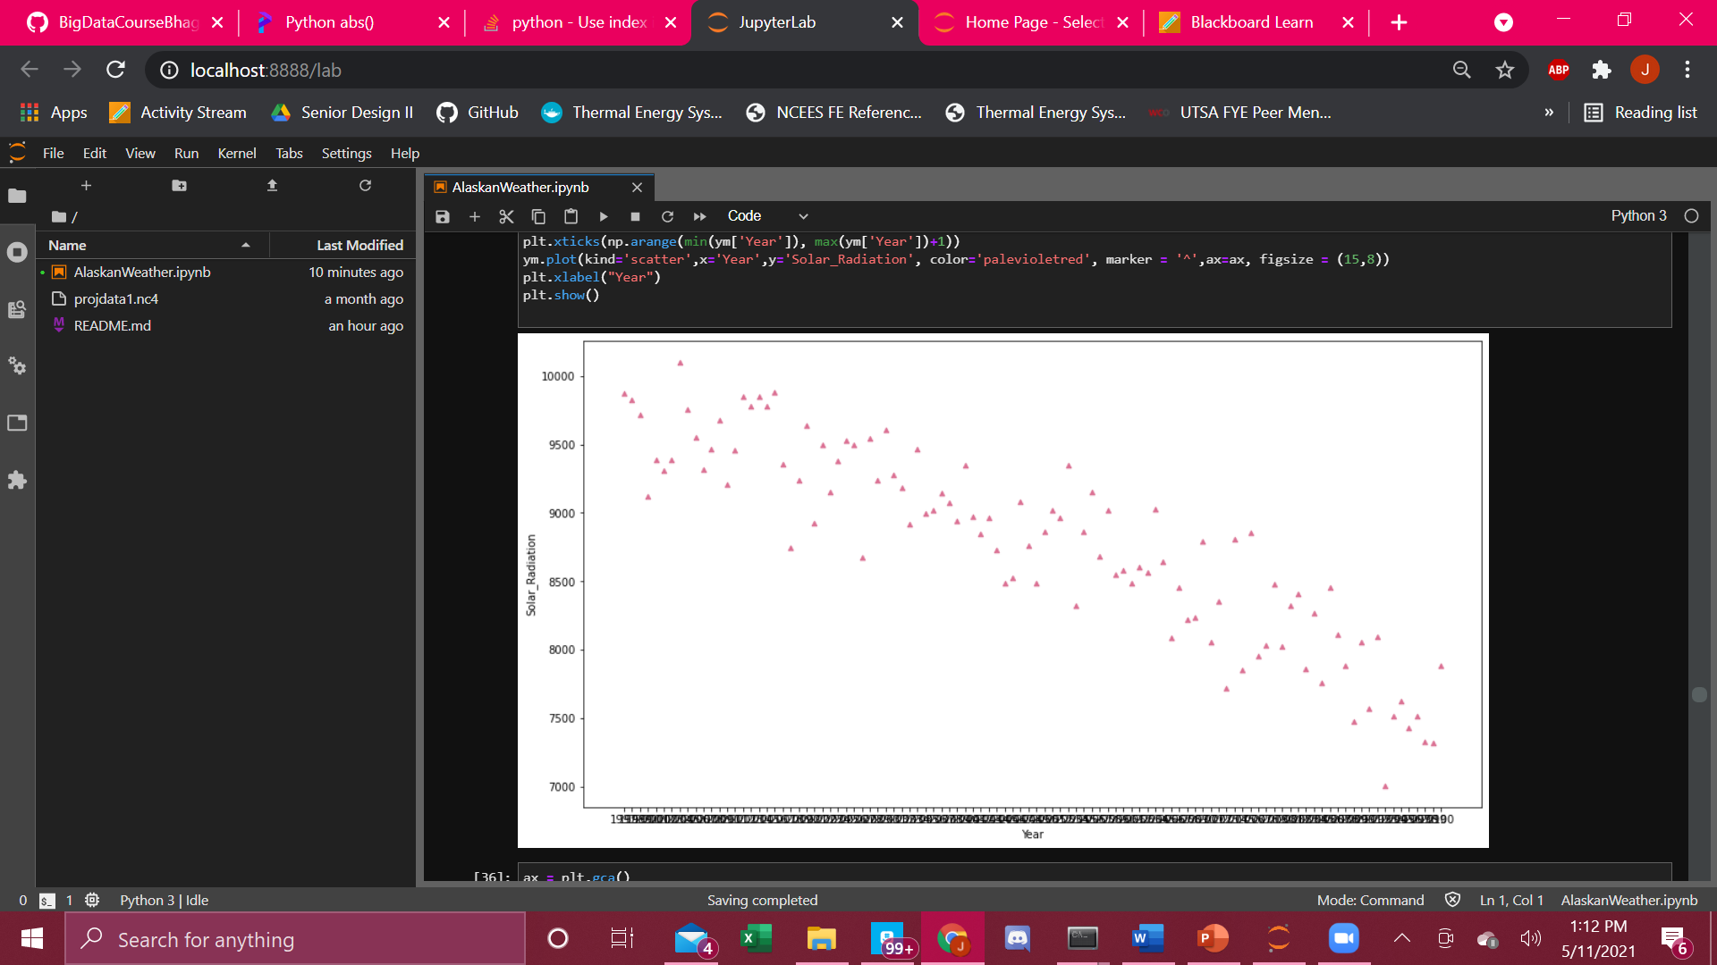

Correlation Analysis

Slide 12
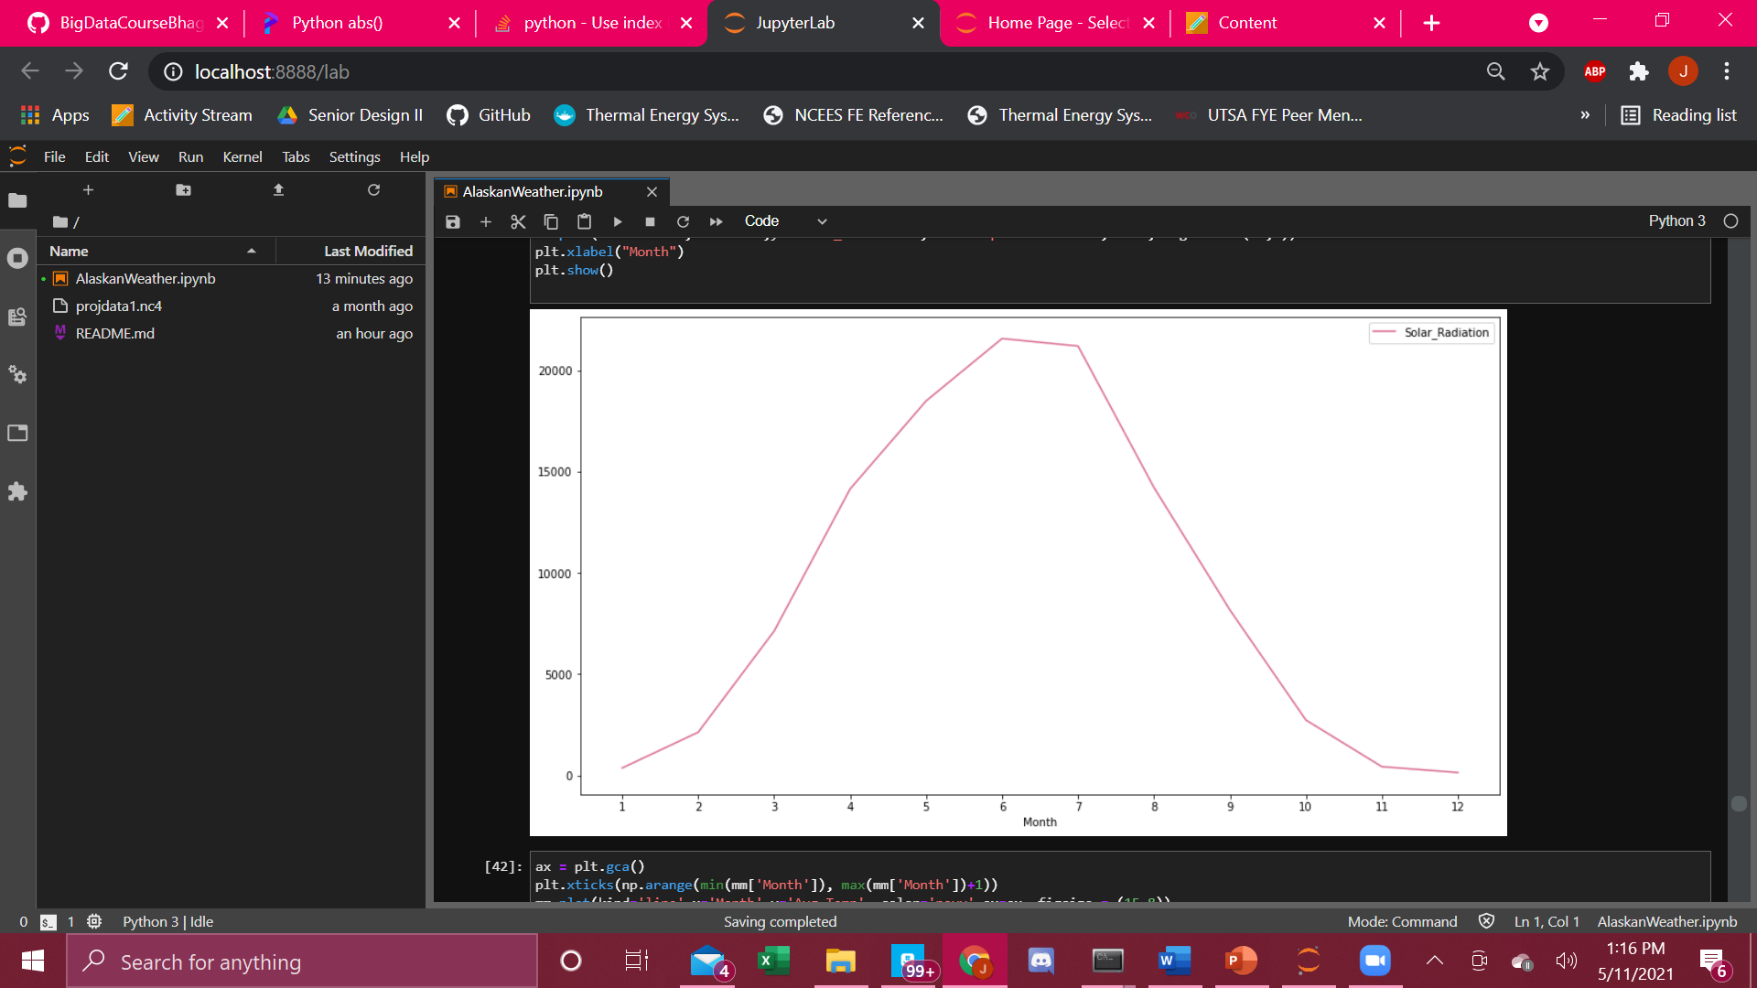
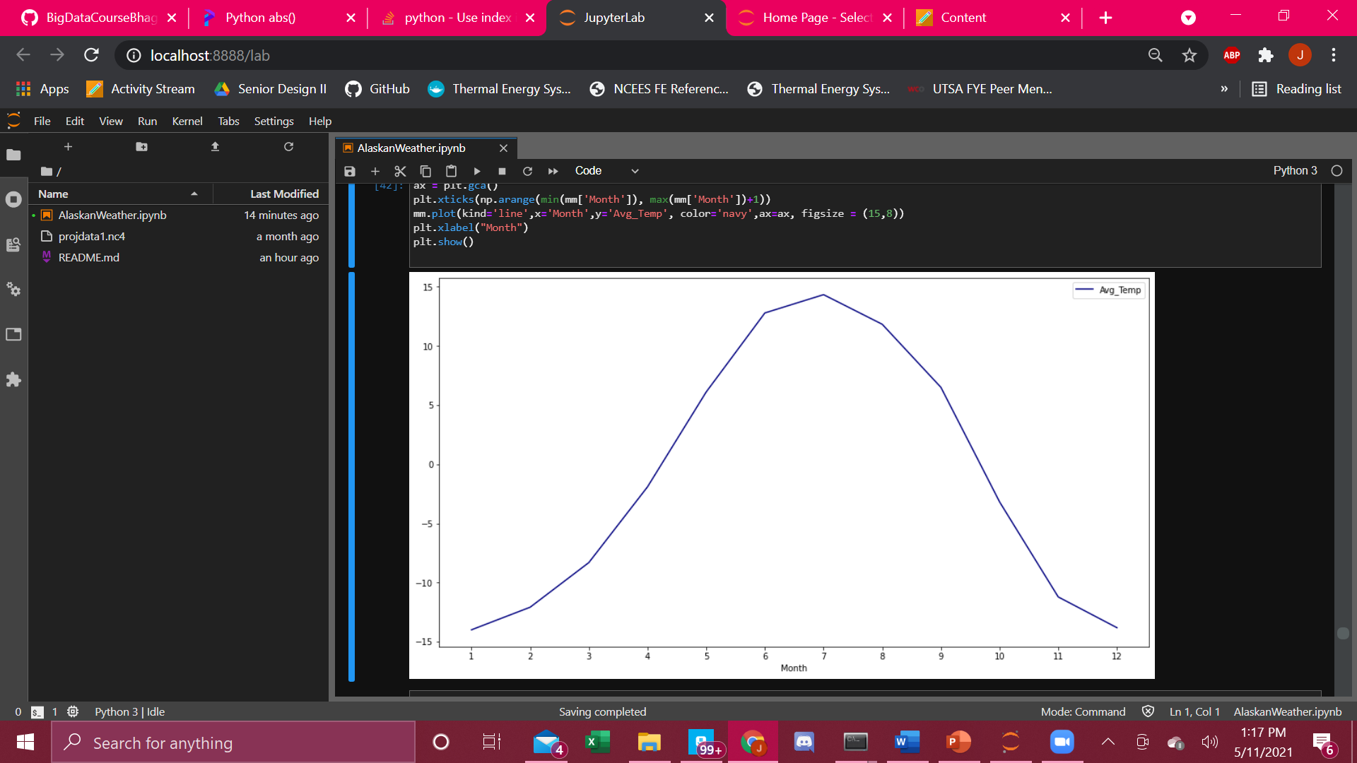
Correlation Analysis

Slide 13
Conclusion
From this analysis, it’s been observed that the latitude coordinate does in fact have an effect on the many components of weather.
The average temperature, relative humidity, irradiation, solar radiation, precipitation, vapor pressure, and the ambient dewpoint increase with increasing latitude values, while the heat index decreases.
It was also found that throughout an average year, Alaska’s absence of sun causes a drop in the vapor pressure, average temperature, solar radiation, and precipitation, but a spike in the relative humidity.

